Slide 1

DATA CHALLENGE – THE ART OF THE POSSIBLE
Ashish Ahuja
9th March 2021

Slide 2

Agenda
Dataset and Business Process
Exploratory Data Analysis
Prediction Model
Forecasting Model
Summary & Improvements

Slide 3
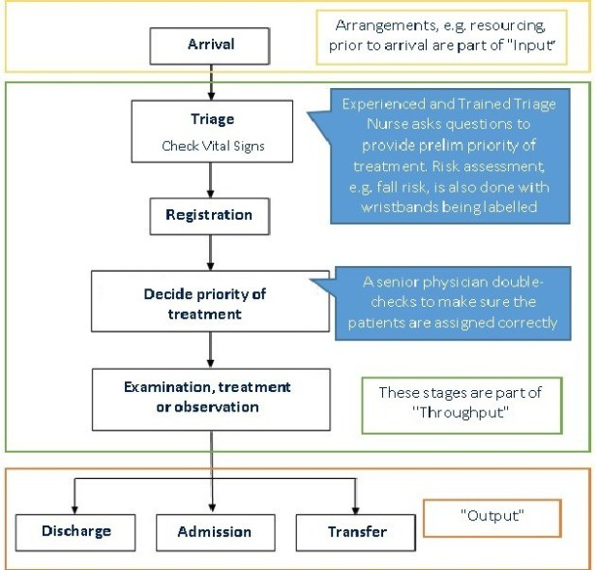
Dataset & Business Process
HOSPITAL EMERGENCY DEPARTMENT DATASET
Number of Observations = 30188
Number of Features = 17
Categorical:
Depart Status Code
Departure Status Desc.
Depart Dest. Code
Depart Dest. Desc.
Presenting Complaint Desc.
Diag Code
Diagnosis Desc.
Numerical:
MRN
Presentation Visit Number
Triage Priority
Age (yrs)
TimeDiff Actual –Actual Depart (mins)
TimeDiff TreatDrNr – Act. Depart (mins)
Presenting Complaint Code
Date:
Arrival Date
Dr Seen Date
Depart Actual Date

Slide 4




Exploratory Data Analysis
DEPARTMENT MANAGEMENT & PLANNING
PATIENT DEMAND FORECASTING
PATIENT COMPLAINTS & DIAGNOSIS ANALYSIS

Slide 5
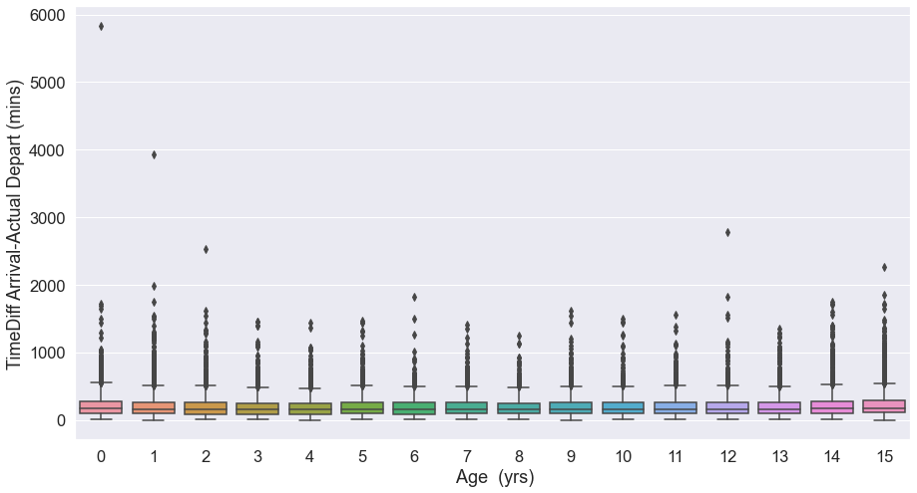
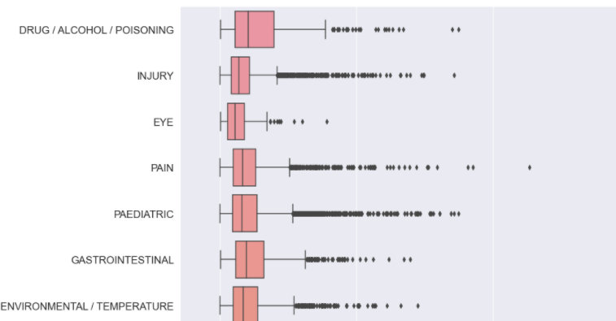
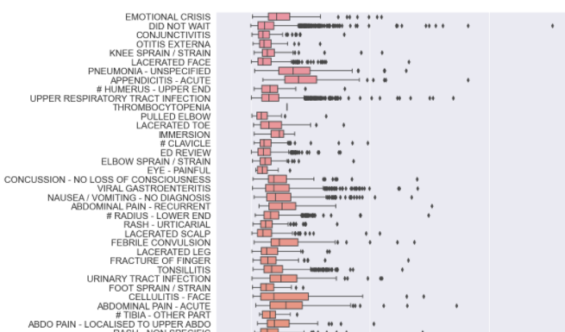
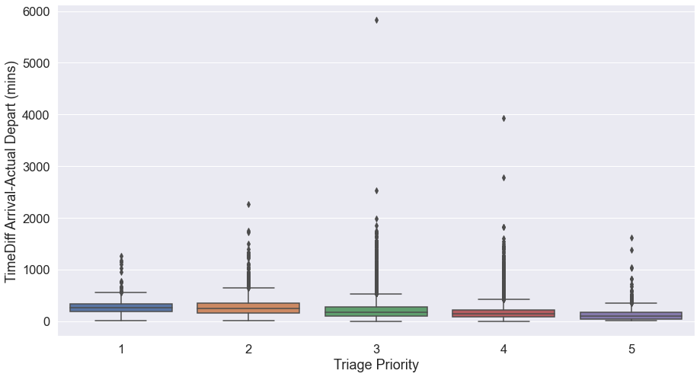
Exploratory Data Analysis
DEPARTMENT MANAGEMENT & PLANNING
Factors affecting total time spent by patients
KEY INSIGHTS:
Total time affected by complaint, diagnosis, age, triage priority
Right skewed distribution
Department management/planning impacted
ACTIONABLE ITEMS:
Determine causes for skewness (longer total times)
BUSINESS PERSPECTIVE:
Prediction of total treatment time for a patient
KEY DRIVERS:
Better resource planning
Improved department management

Slide 6
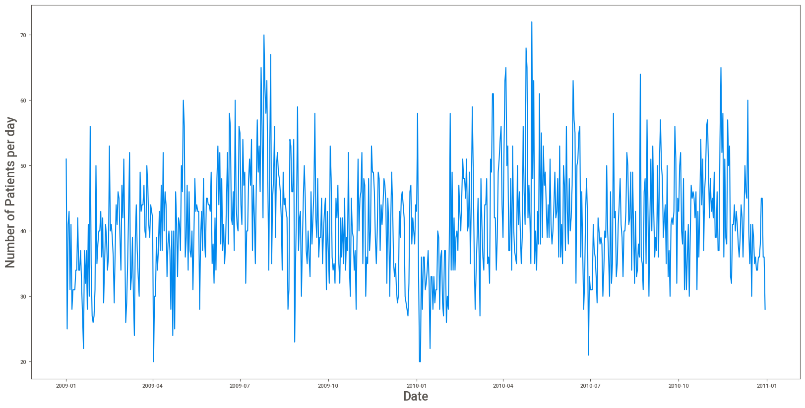
Exploratory Data Analysis
PATIENT DEMAND ANALYTICS
Number of patients per day
KEY INSIGHTS:
Seasonal pattern, count dependent on month, year
Peaks related to external factors
ACTIONABLE ITEMS
Determine external factors causing peak demand
BUSINESS PERSPECTIVE:
Forecasting of daily patient count
KEY DRIVERS:
Demand Forecasting, Manpower planning
PREDICTORS
Historical patient count per day

Slide 7
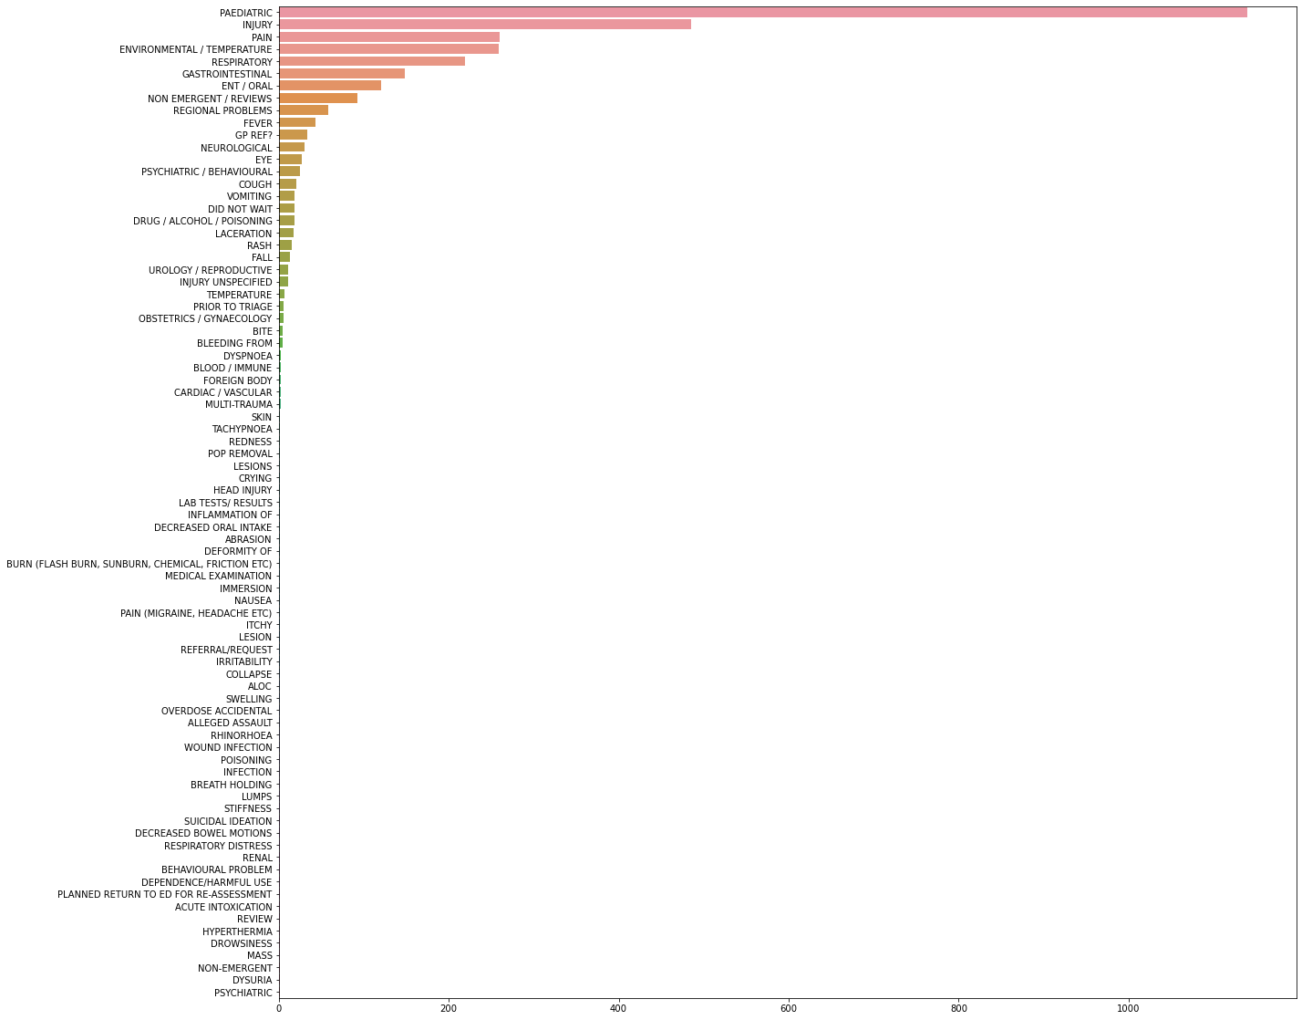
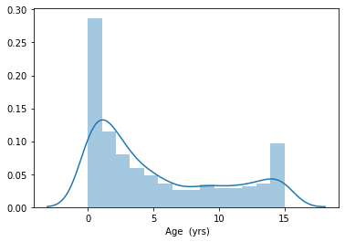
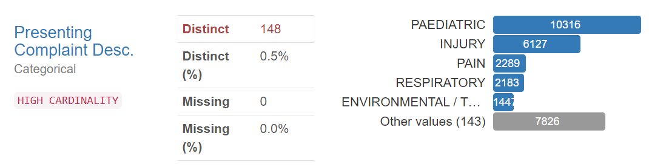
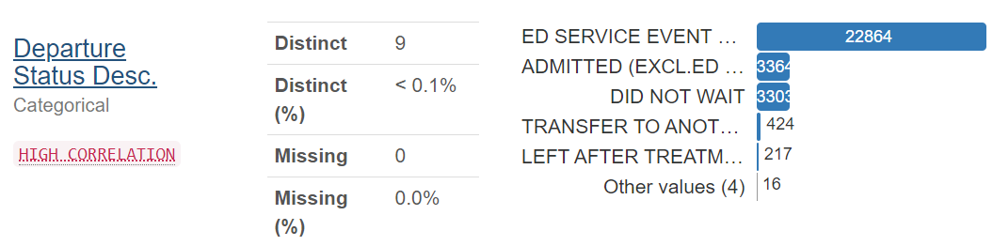
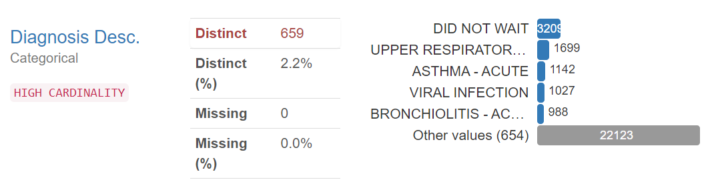
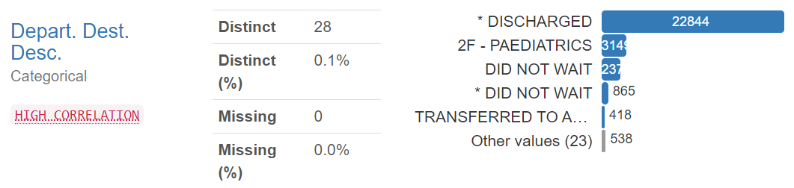
Exploratory Data Analysis
PATIENT COMPLAINTS & DIAGNOSIS ANALYSIS
KEY INSIGHTS:
0-3 years age group most common
‘DID NOT WAIT’ for diagnosis
ACTIONABLE ITEMS:
Check resource allocation to Paediatric section and ‘DID NOT WAIT’ category
BUSINESS PERSPECTIVE:
Patient Segmentation
KEY DRIVERS:
Categorization of risk/severity
Improved patient service
7

Slide 8
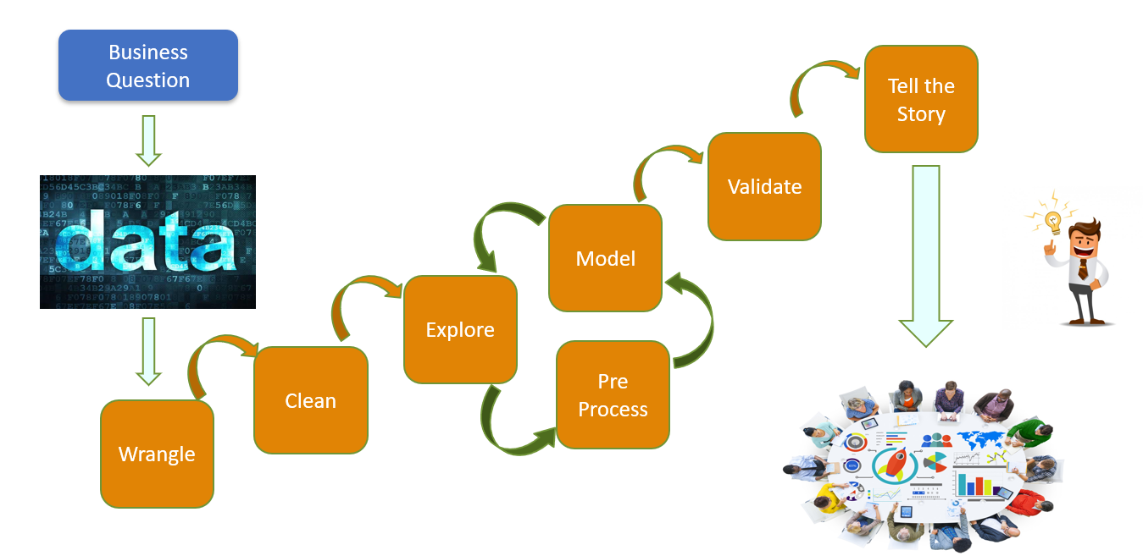
Data Pipeline and Approach

Slide 9
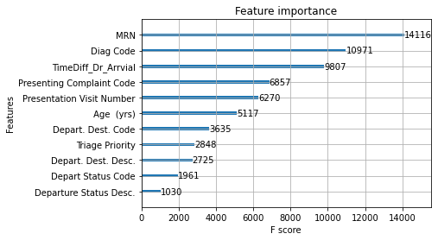
Business Perspective
PREDICTION OF TOTAL TREATMENT TIME
MODEL PARAMTERS & EVALUATION
Target | TimeDiff Arrival-Actual Depart (mins)
Type | Regression
Model | Extreme Gradient Boosting (XGBOOST )
Categorical | Target Encoding
Training Metrics |  | Testing Metrics
R-squared | 0.72 | R-squared | 0.29
Adj. R-sq. | 0.72 | Adj. R-sq. | 0.28
MAE | 61.06 | MAE | 90.03
MAPE | 50.31 | MAPE | 66.07
RMSE | 92.00 | RMSE | 149.90
Note: Departure Status, Code, Description information assumed to be available at the time of prediction

Slide 10
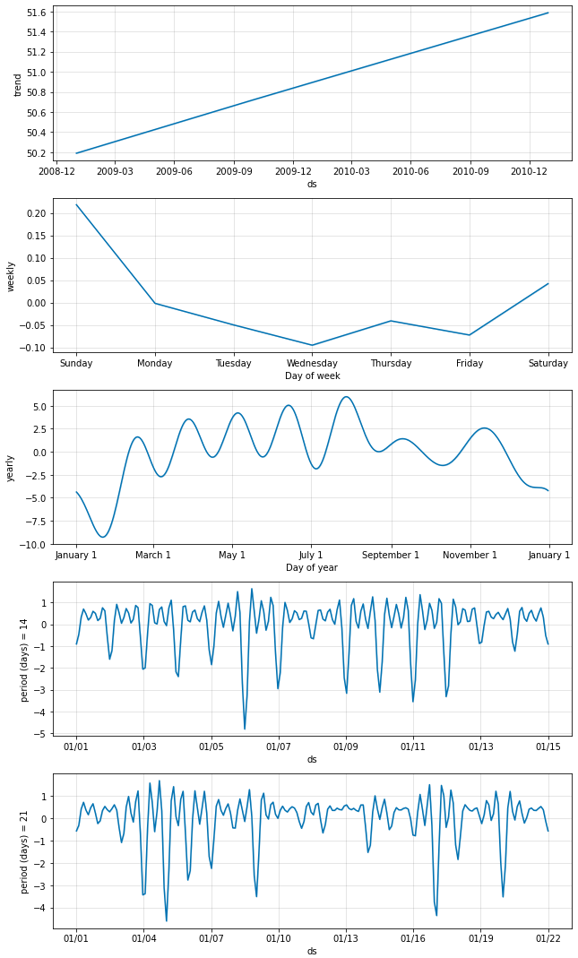
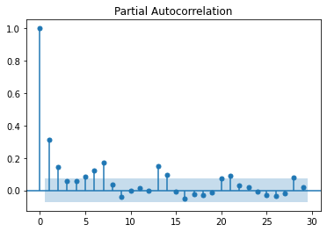
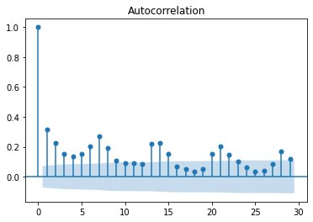
Business Perspective
FORECASTING OF DAILY PATIENT COUNT
Time Series Forecasting using Prophet
Trend
Seasonal Components
Fourier Coefficients

Slide 11
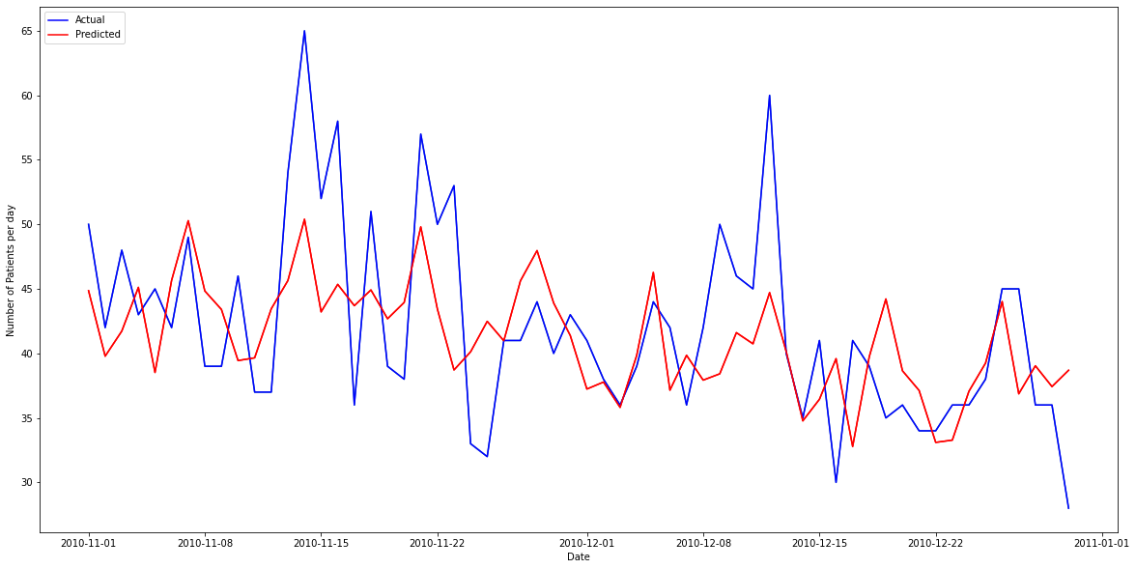
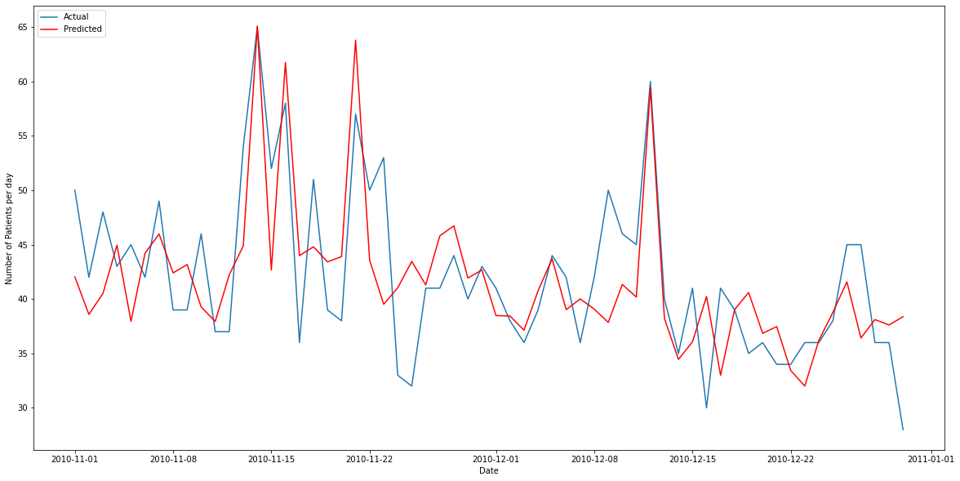
Business Perspective
FORECASTING OF DAILY PATIENT COUNT
Forecasting using Trend, Seasonality
Forecasting using Trend, Seasonality and Exogenous Feature
Performance Metrics without Exogenous Feature
RMSE | MASE | MAE | MAPE
6.35 | 0.81 | 5.08 | 11.89
Performance Metrics with Exogenous Feature
RMSE | MASE | MAE | MAPE
5.53 | 0.69 | 4.36 | 10.59

Slide 12

Summary & Improvements
Predictive Model for Total Time till Departure for Planning and Management
Patient Count Estimation using Time Series Forecasting for Resource Scheduling
Patient Segmentation in risk, severity categories for Operational Efficiency
Hyper Parameter Tuning

